Slide 1
Estimation of Basketball Shot Trajectory
Duan Wang
Jintian Zhu
Dan Webb

Slide 2
Goal
Use a dual video camera setup
Estimate trajectory of ball from the first couple frames using optical flow and disparity

Slide 3
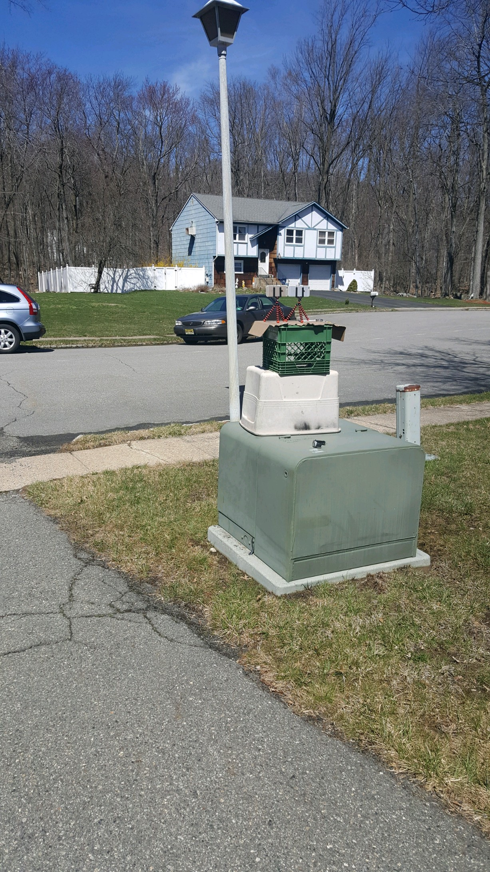
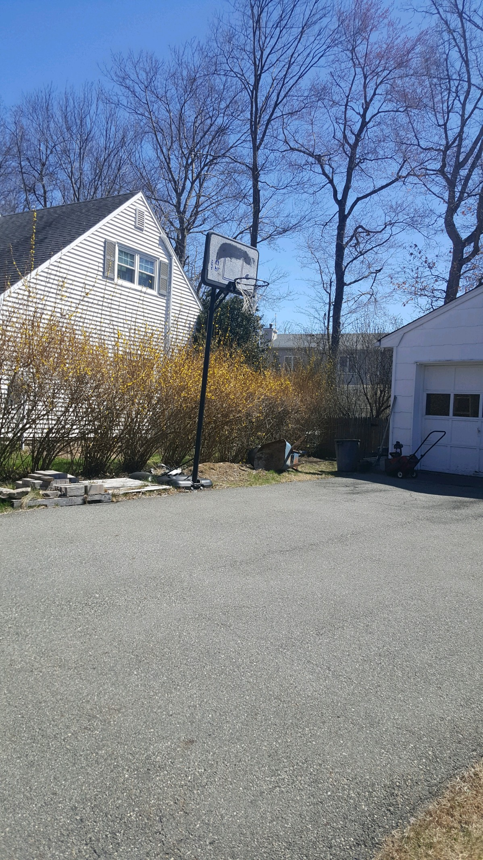
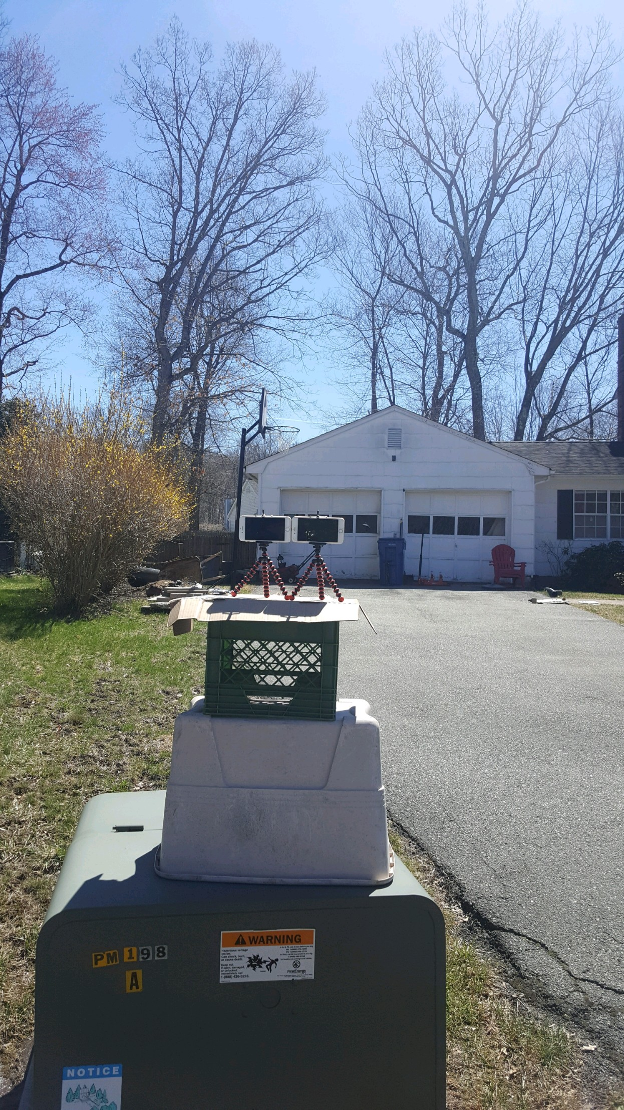
Experiment Setup

Slide 4
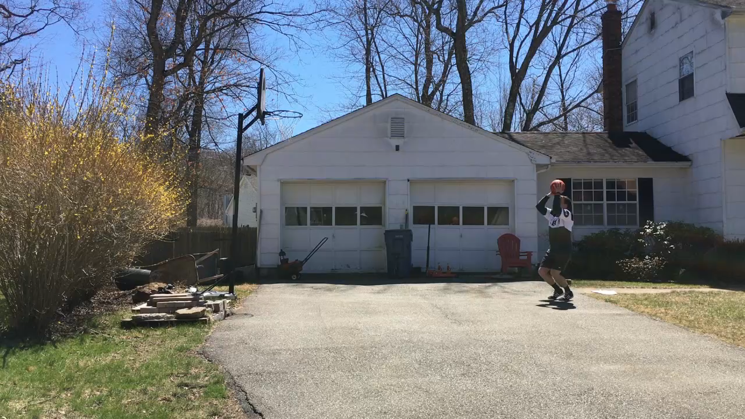
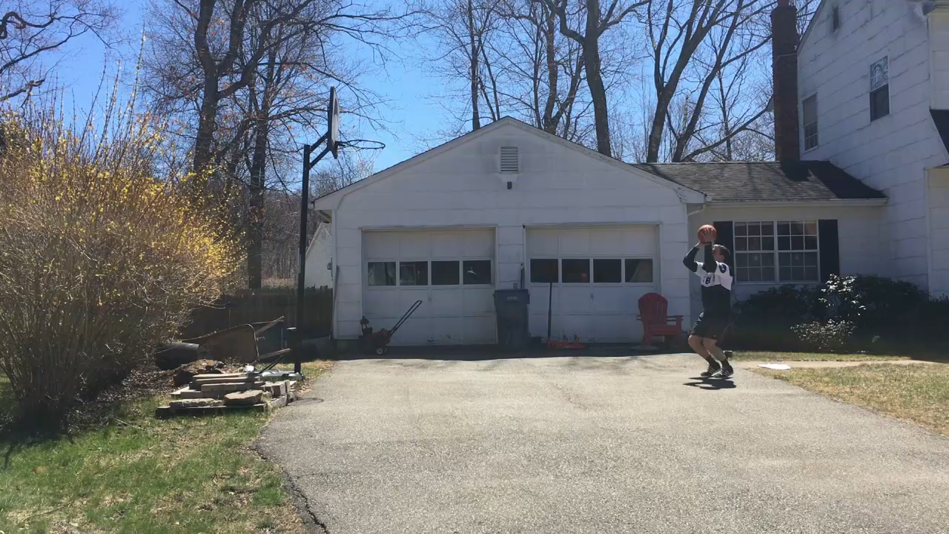
Footage

Slide 5
Methodology
Use circle detecting algorithm to obtain region of interest to us
Calculate optical flow over smoothed images
Calculate depth using one camera and radius of ball
Use only first couple of frames in video to obtain velocity vectors and estimate projection curve

Slide 6
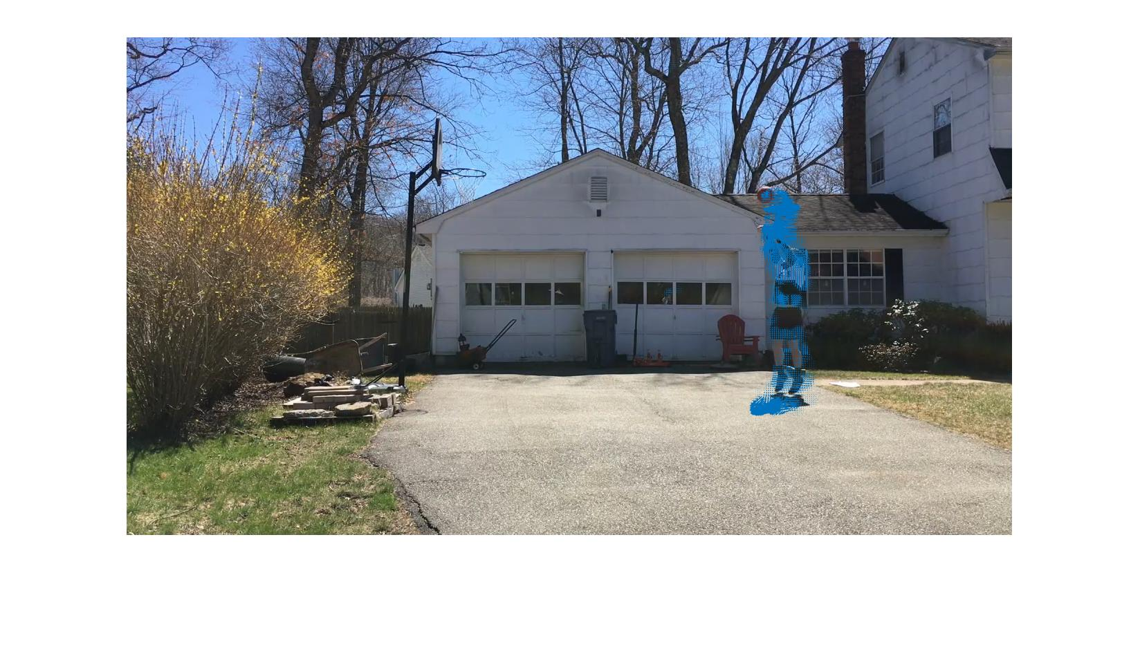
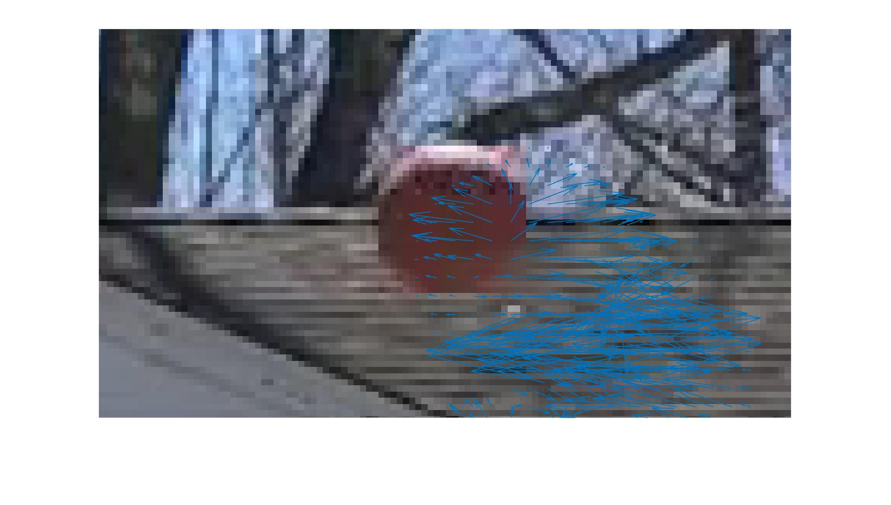
Preliminary Results
Farneback Method provides a dense optical flow estimation

Slide 7
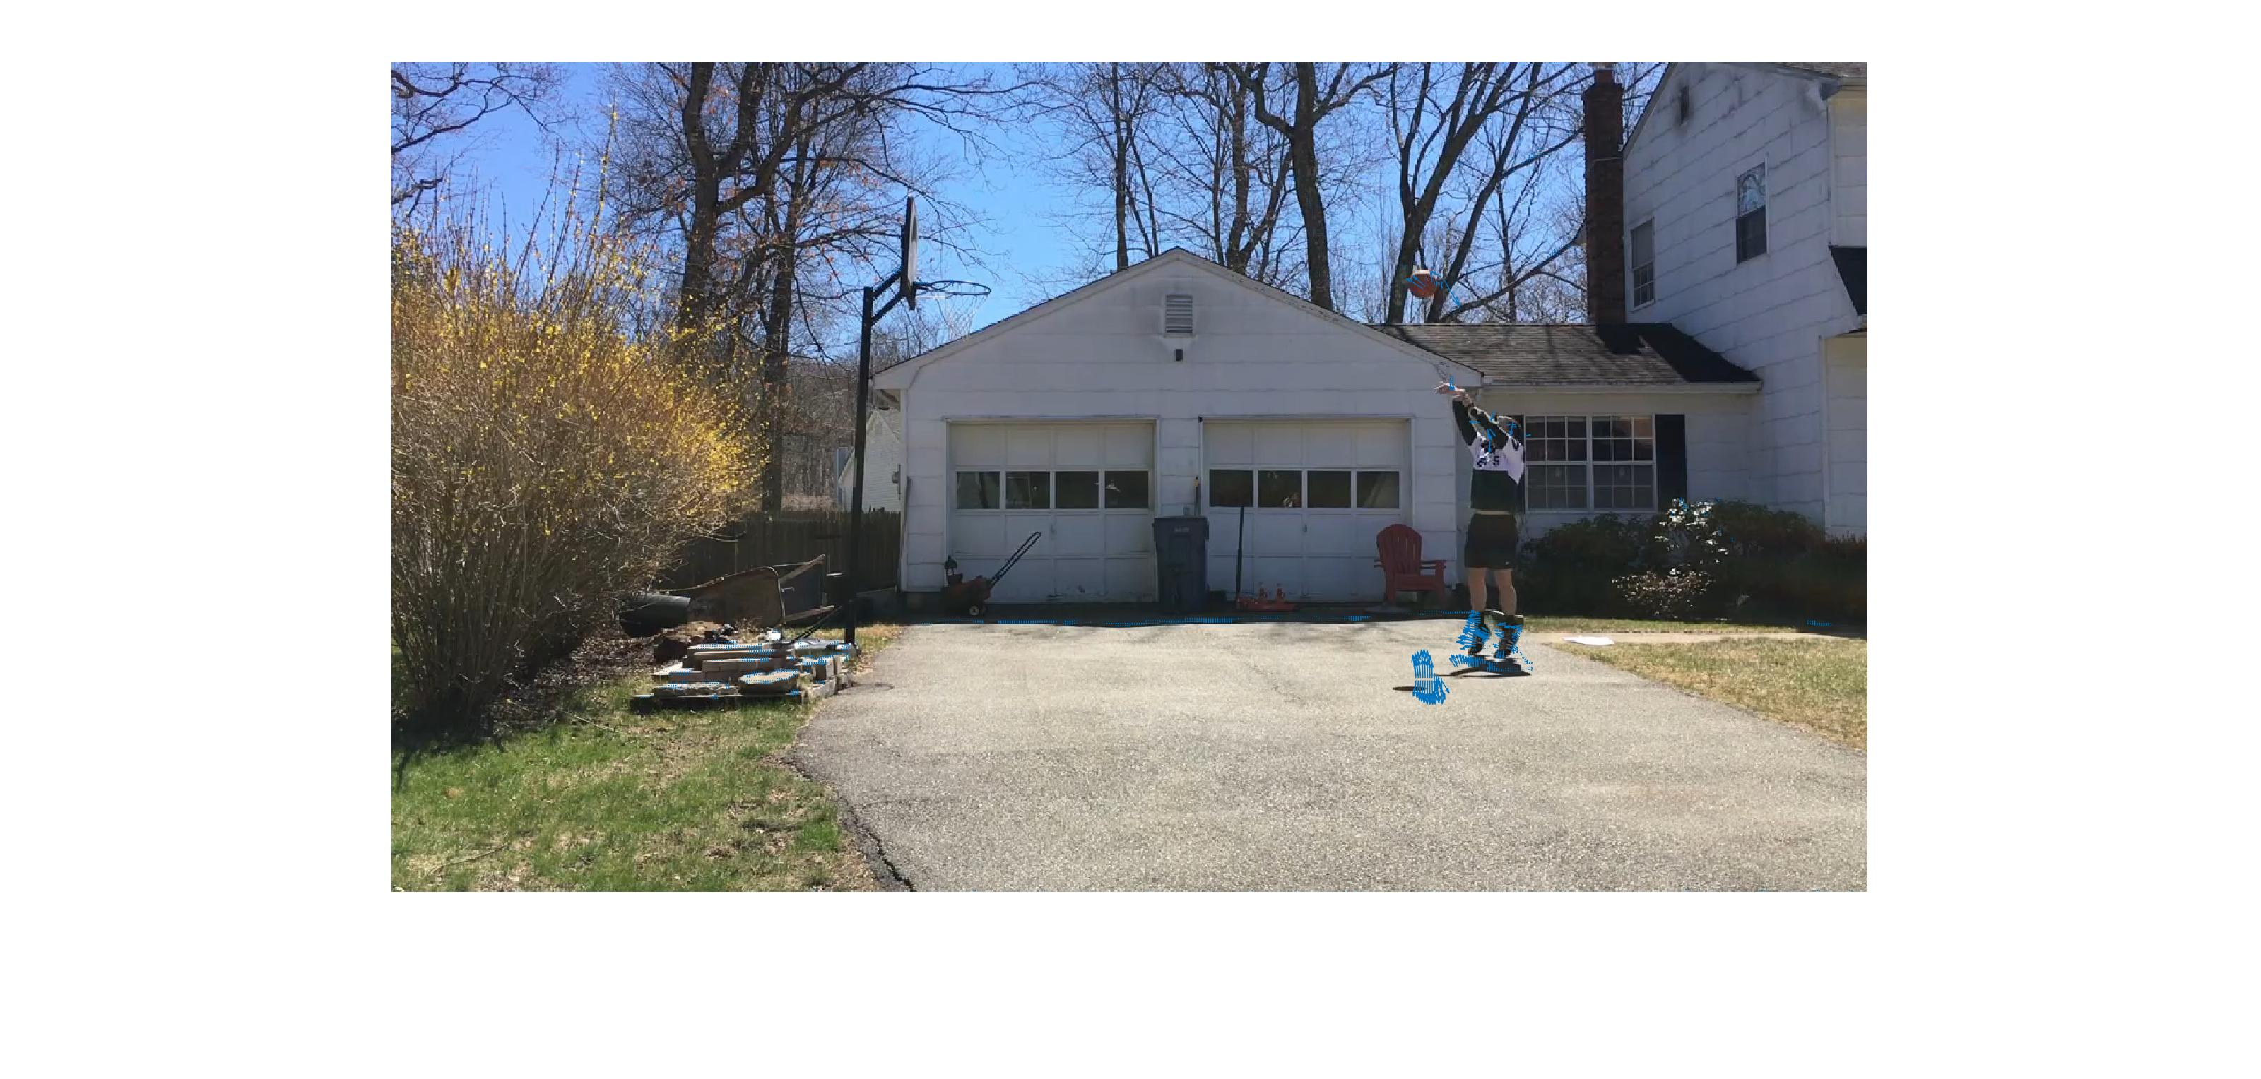
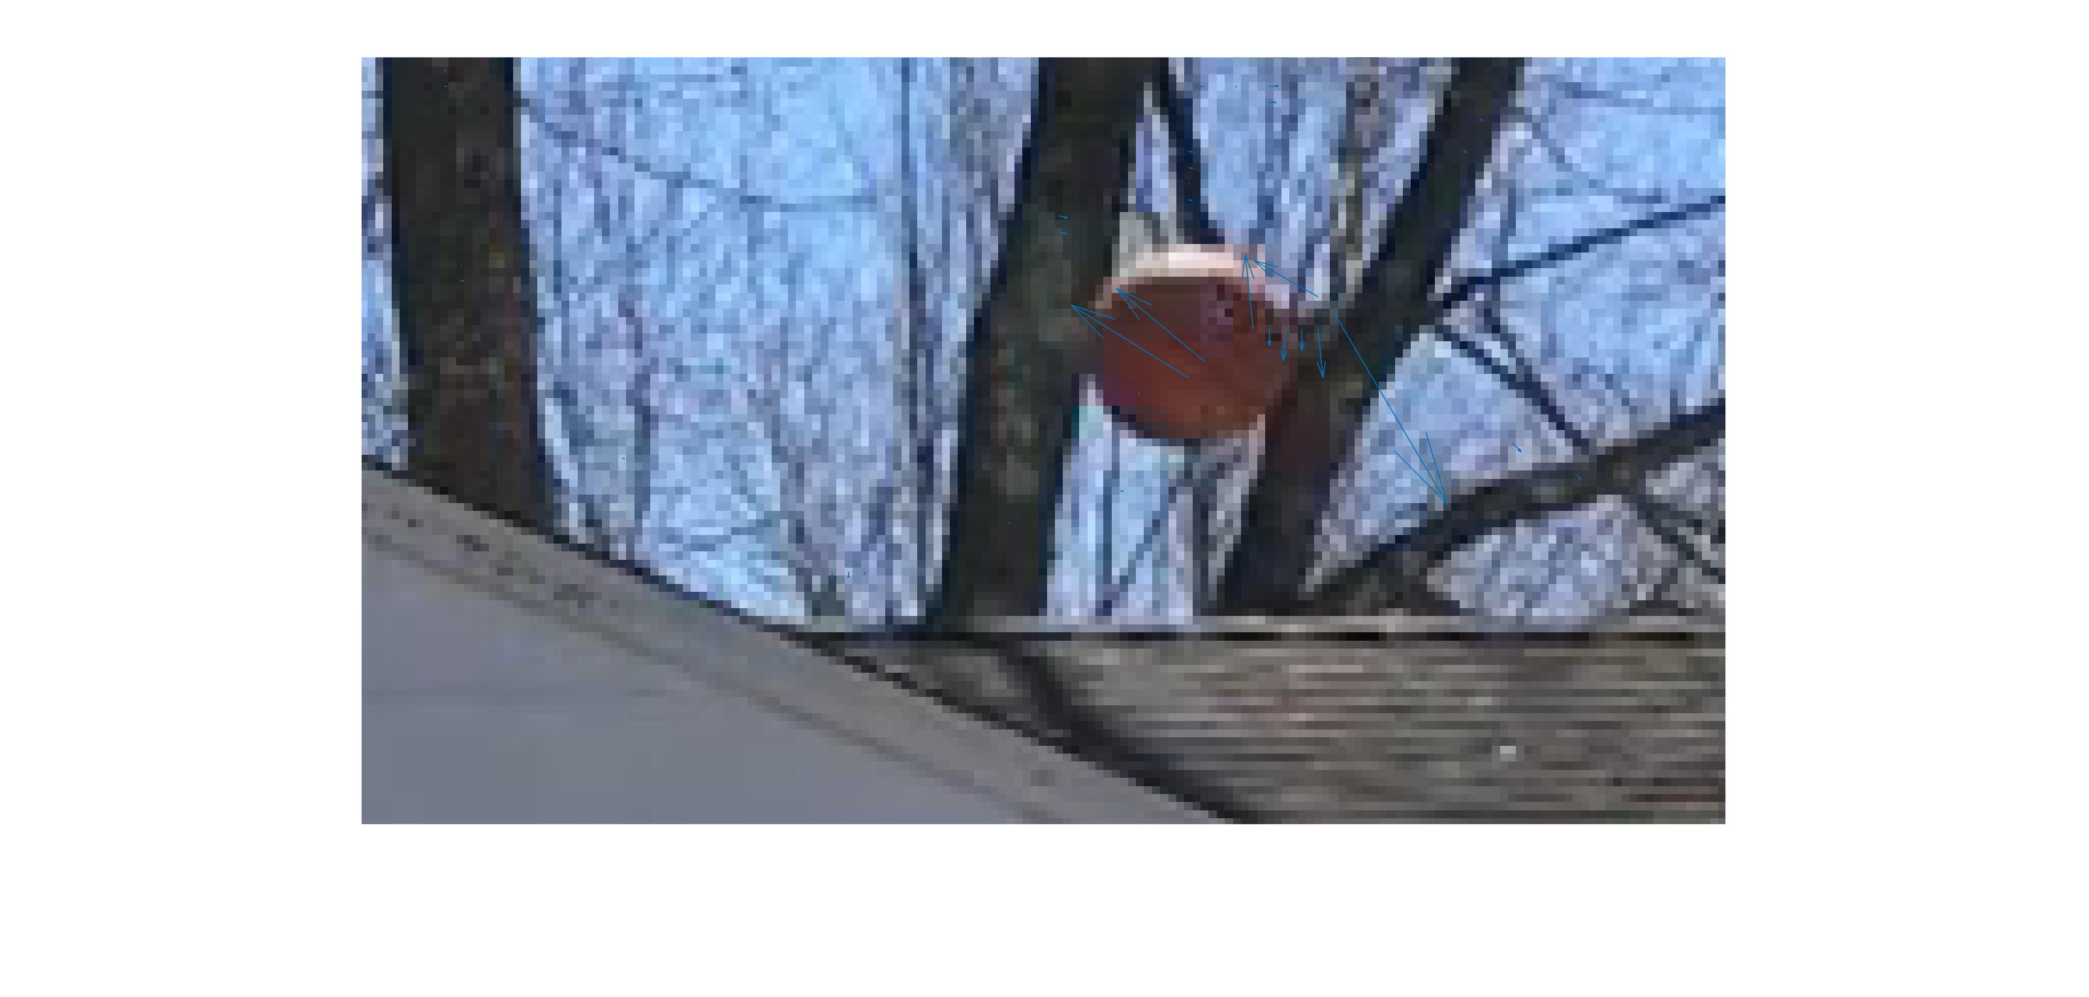
Preliminary Results
Lucas-Kanade

Slide 8
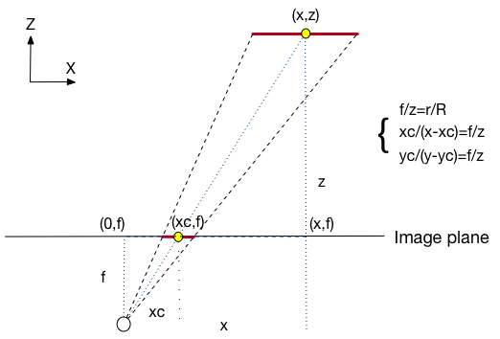
Calculating Depth
Regular disparity produced lots of noise because we could not exactly sync our frames in time

Slide 9
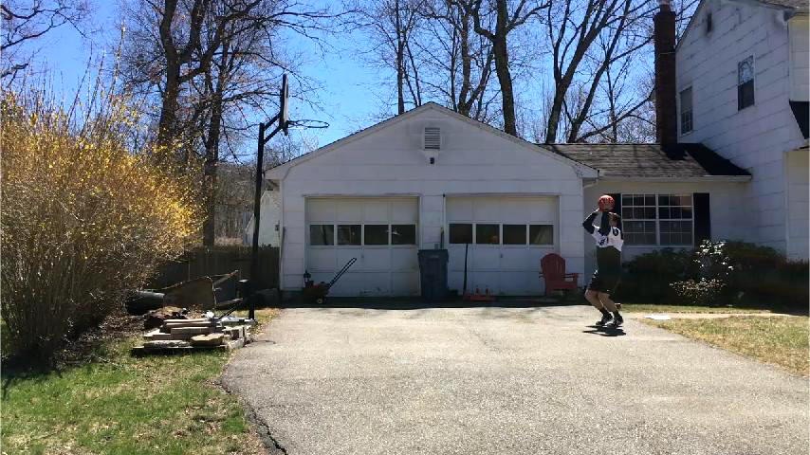
Estimating Trajectory in 2D

Slide 10
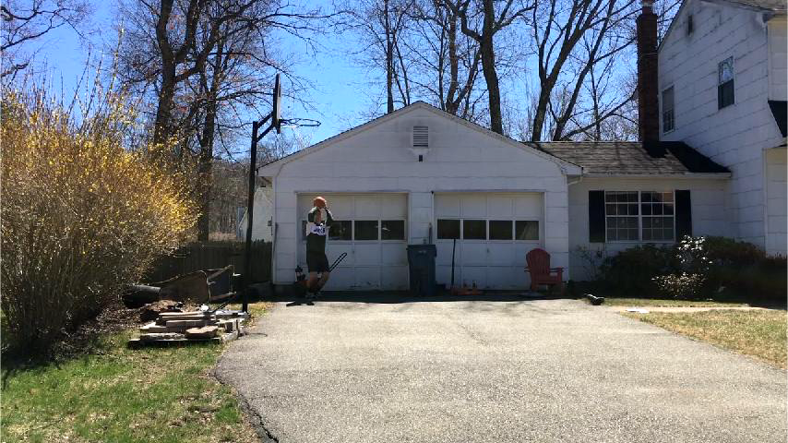
Estimating Trajectory in 2D

Slide 11
Challenges
Optical flow on noisy image, even after smoothing
Sunlight hitting ball distorts colors of the object
May have to do with the resolution of the photo as the ball is very far from the camera.
Will instead plot trajectory using ball centers and disparity from radius obtained by the circle detection algorithm and use this plotting to evaluate multiple optical flow methods and determine which would work best in our very noisy situation and why.

Slide 12
Questions?

